Slide 1
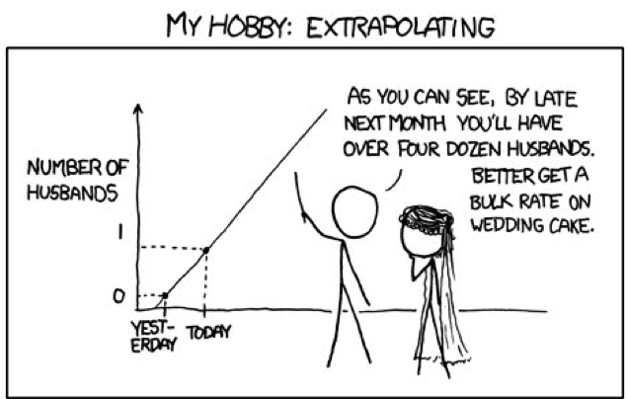
Forecasting,
Extrapolation and Uncertainty
http://xkcd.com
Notes:
Climate change, and the ecoloigcal response to it

Slide 2
Outline
Types of extrapolation
Environment*
Space
Time
Uncertainty
Modeling decisions
Parameters
Future Scenarios
Where can
biology provide guidance?

Slide 3
Environmental Extrapolation

Slide 4
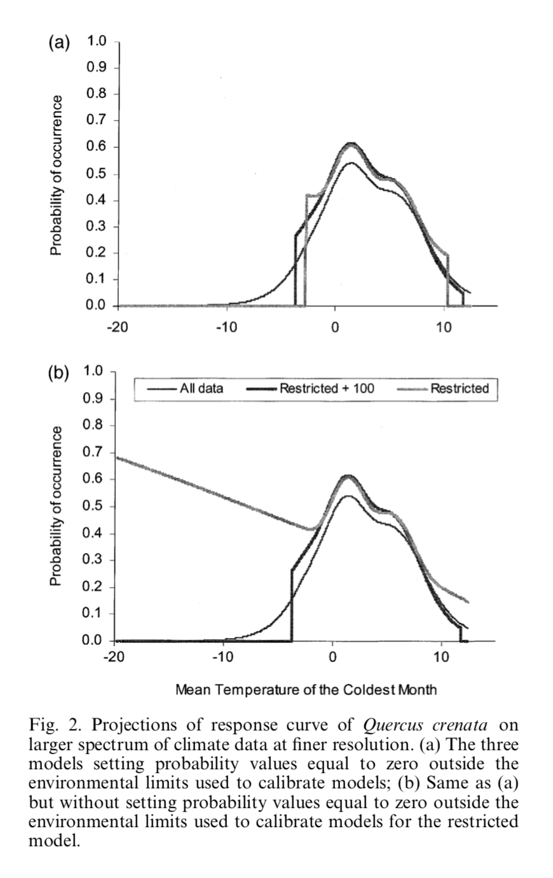
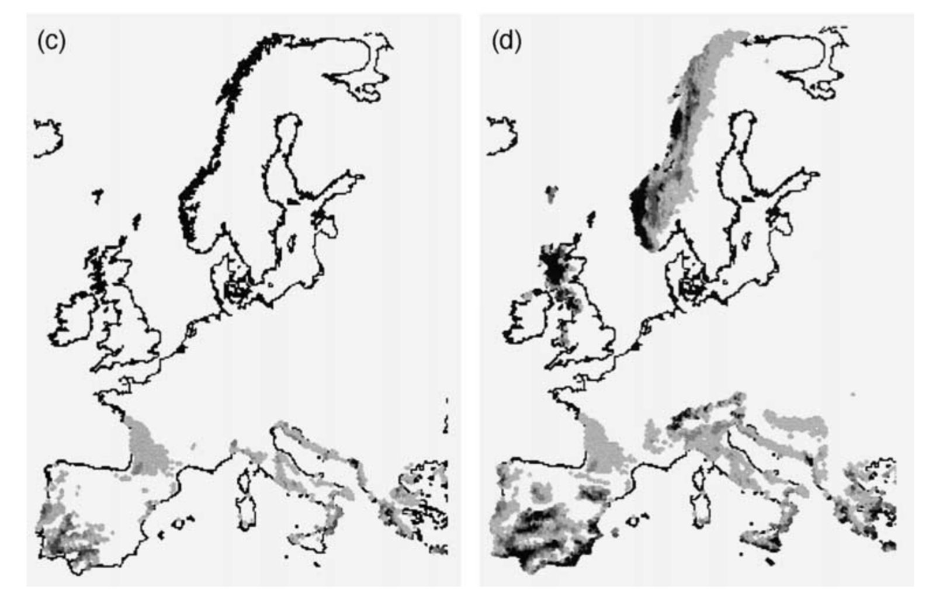
Extrapolation
clamping
oops
Thullier et al. 2004

Slide 5
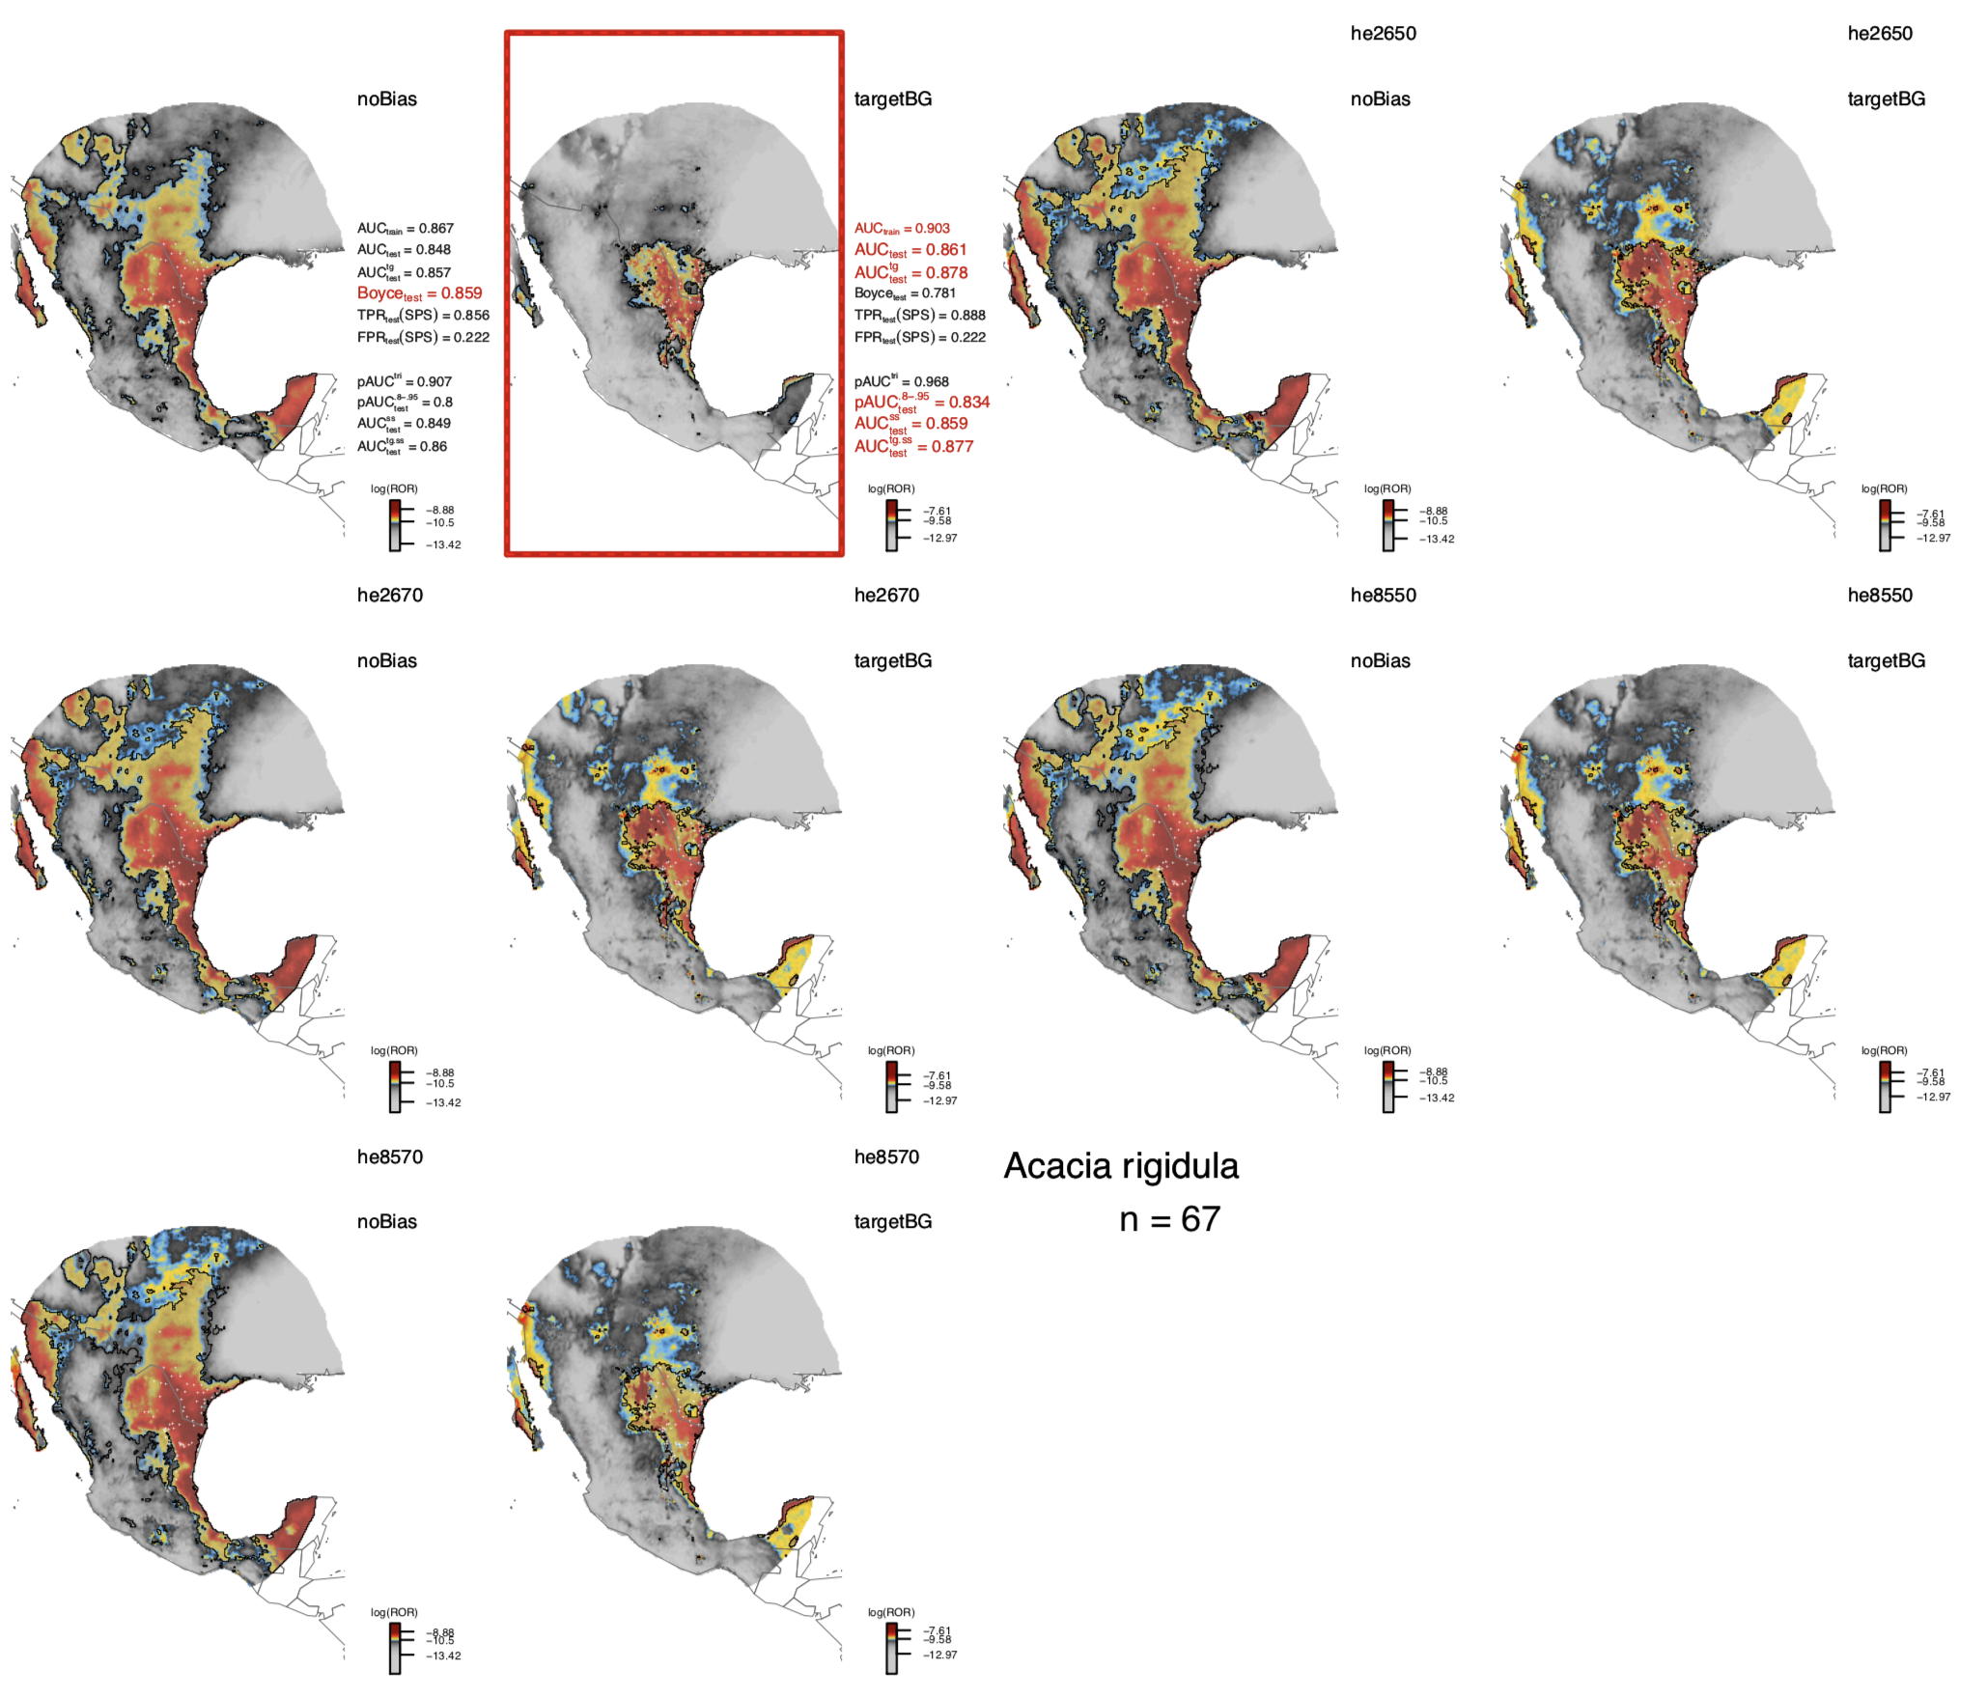
Forecasting
Notes:
We have to do this all the time to predict many species responses to climate change
Focus on 2nd column

Slide 6
What can we do about it?
Don’t do it
Get more data in the range you want to predict
Cross validation

Slide 7
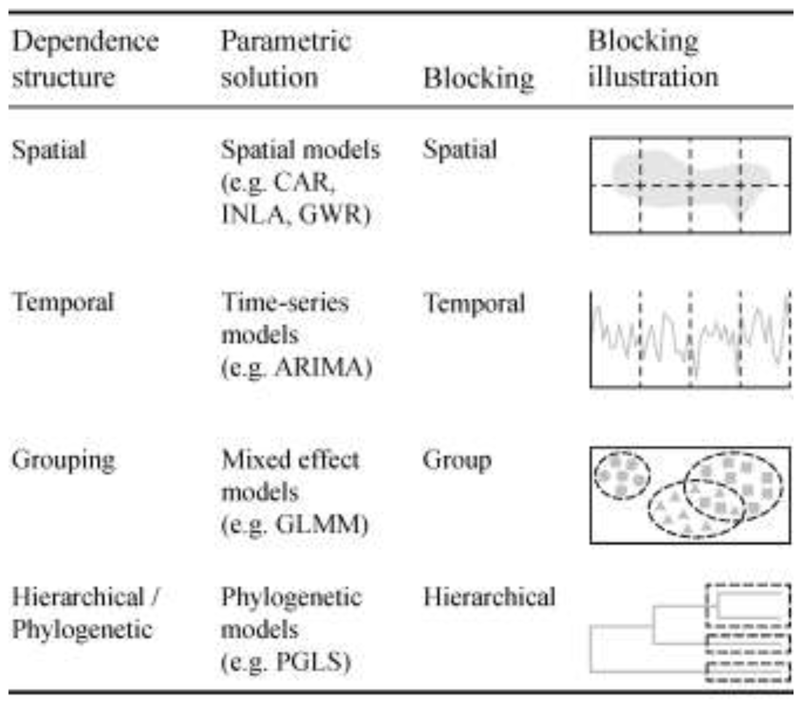
Cross Validation
Roberts et al. 2016, Ecography

Slide 8
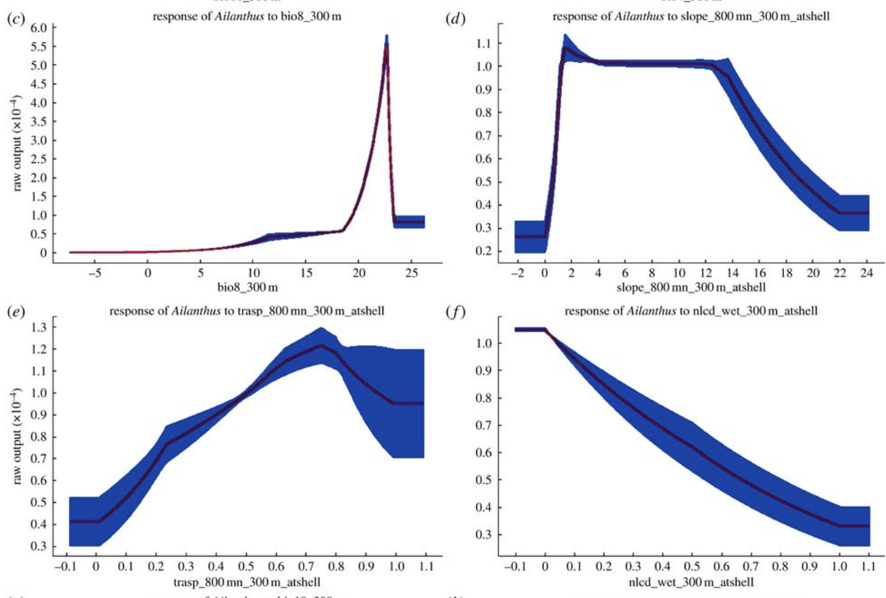
What can we do about it?
Don’t do it
Get more data in the range you want to predict
Cross validation
Constrain it

Slide 9
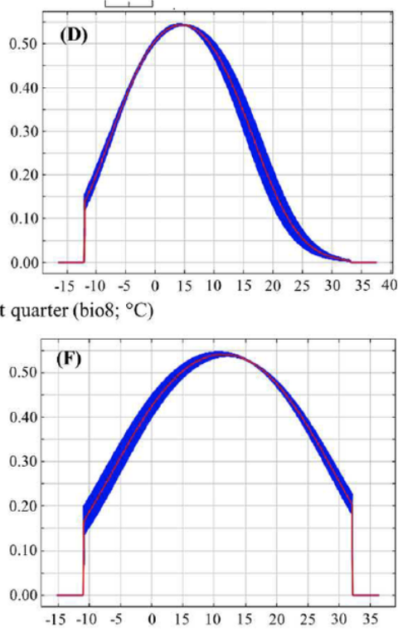
What can we do about it?
Don’t do it
Get more data in the range you want to predict
Cross validation
Constrain it
Make a heuristic argument that its ok

Slide 10
What can we do about it?
Don’t do it
Get more data in the range you want to predict
Cross validation
Constrain it
Make a heuristic argument that its ok
Make a mechanistic model
Predict another emergent pattern to validate the extrapolation with a different type of data

Slide 11
Spatial Extrapolation

Slide 12
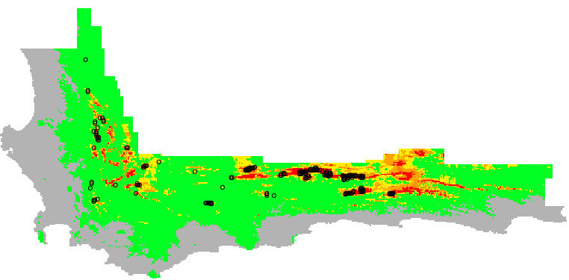
Two cultures of SDMing
occurrence
Bumps attributed to environmental response actually arise in geographic space

Slide 13
Spatial Aggregation and Overfitting
Cold (Suitable)
Warm (Unsuitable)

Slide 14
Overfitting
Cold (Suitable)
Warm (Unsuitable)

Slide 15
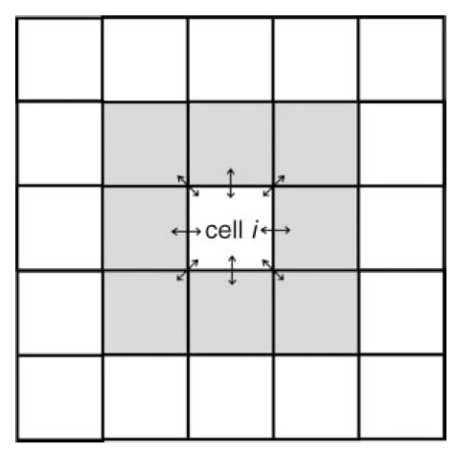
Bayesian Spatial models
Spatial random intercepts
R package: hSDM
Notes:
Conditional Autoregressive Model
no software previously for point models
Uncertainty can be underestimated with spatially correlated data

Slide 16
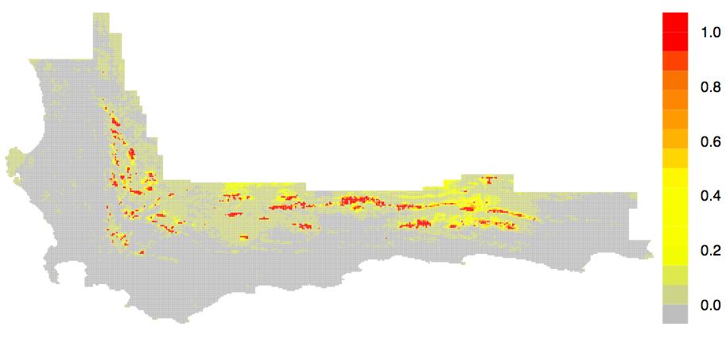
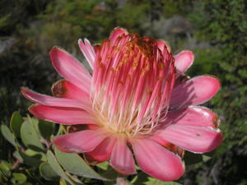
Spatial prediction
Elevation
Mean
Data

Slide 17
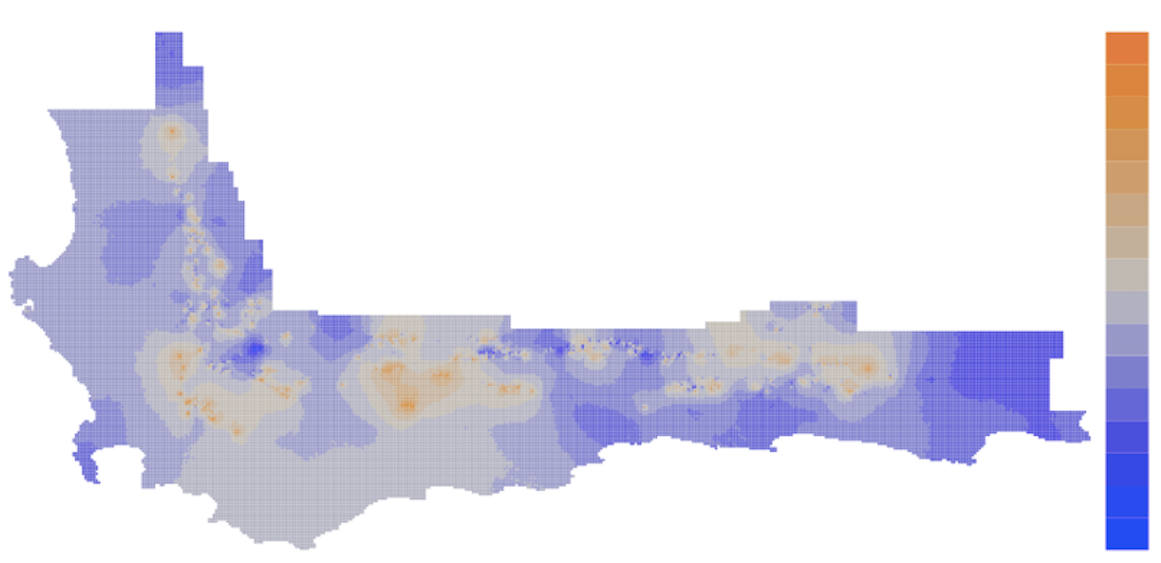
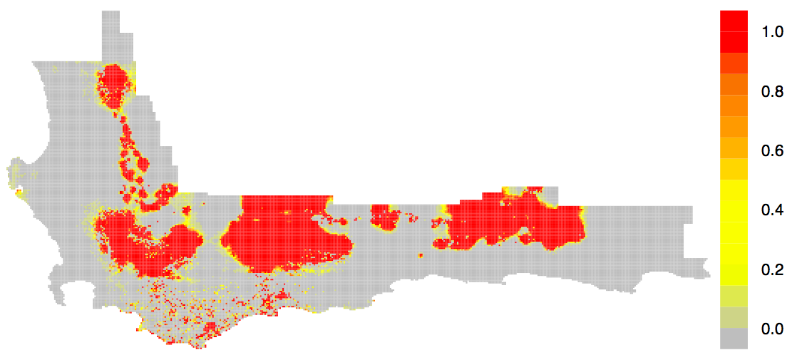
Spatial prediction
Spatial Effects
Data
Accurate Spatial Prediction
Generalization
Notes:
Shows that a lot of predictive accuracy is coming from things that we’ve ommitted from the model.

Slide 18
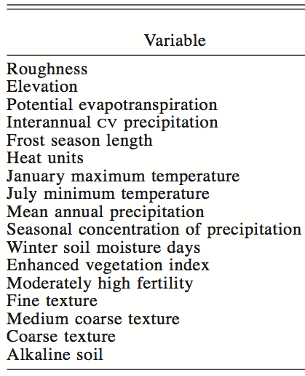
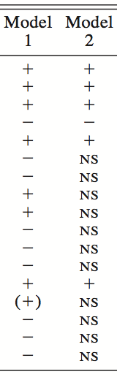
Nonspatial Spatial

Slide 19
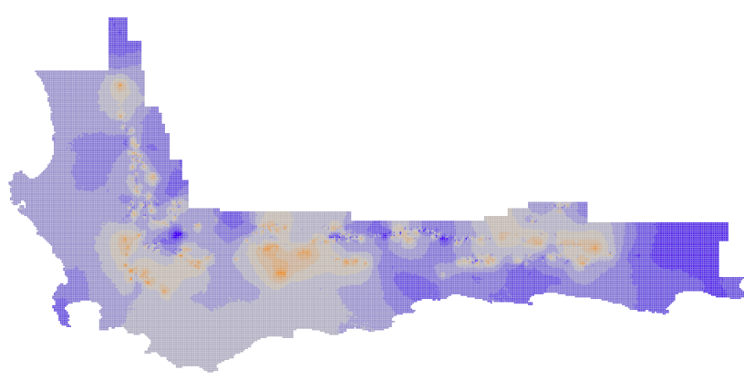
Summary of Spatial Models
Pros
Removes marginal predictors
Describe latent spatial variation
Predictive power + generalization
Cons
Slow-ish
Need lots of data
Static
Notes:
Dispersal
Competition
Environmental

Slide 20
Temporal Extrapolation

Slide 21
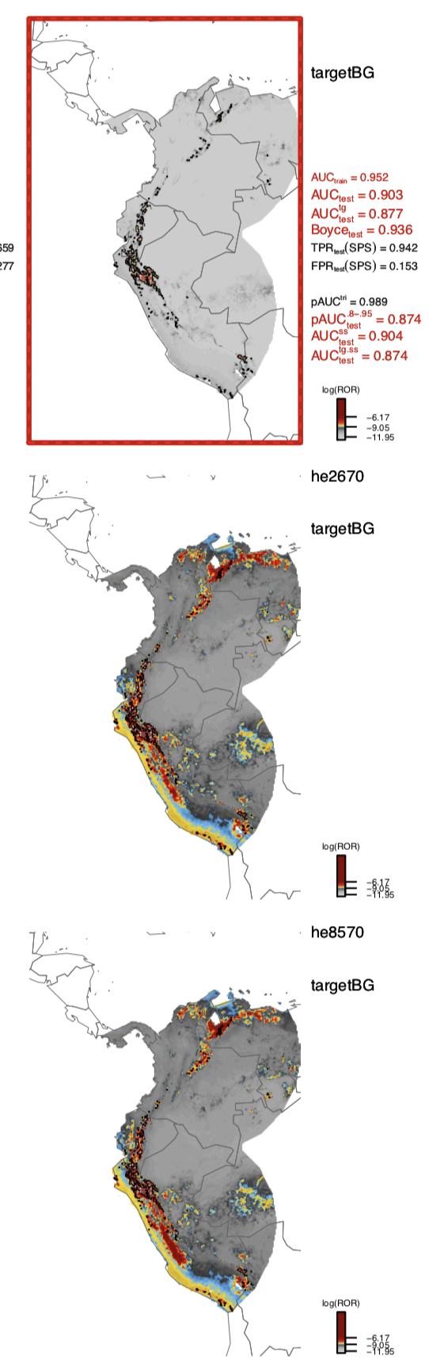
Temporal extrapolation
Correlative models can only take you so far….

Slide 22
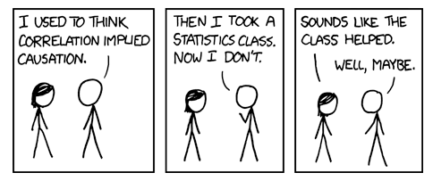
Forecasting
And the need for mechanism…
http://xkcd.com
Notes:
Forecasting often requires extrapolation to new conditions where we have no data, and where models are most uncertain
fire trucks responding to fire/amount of damage the fire does

Slide 23
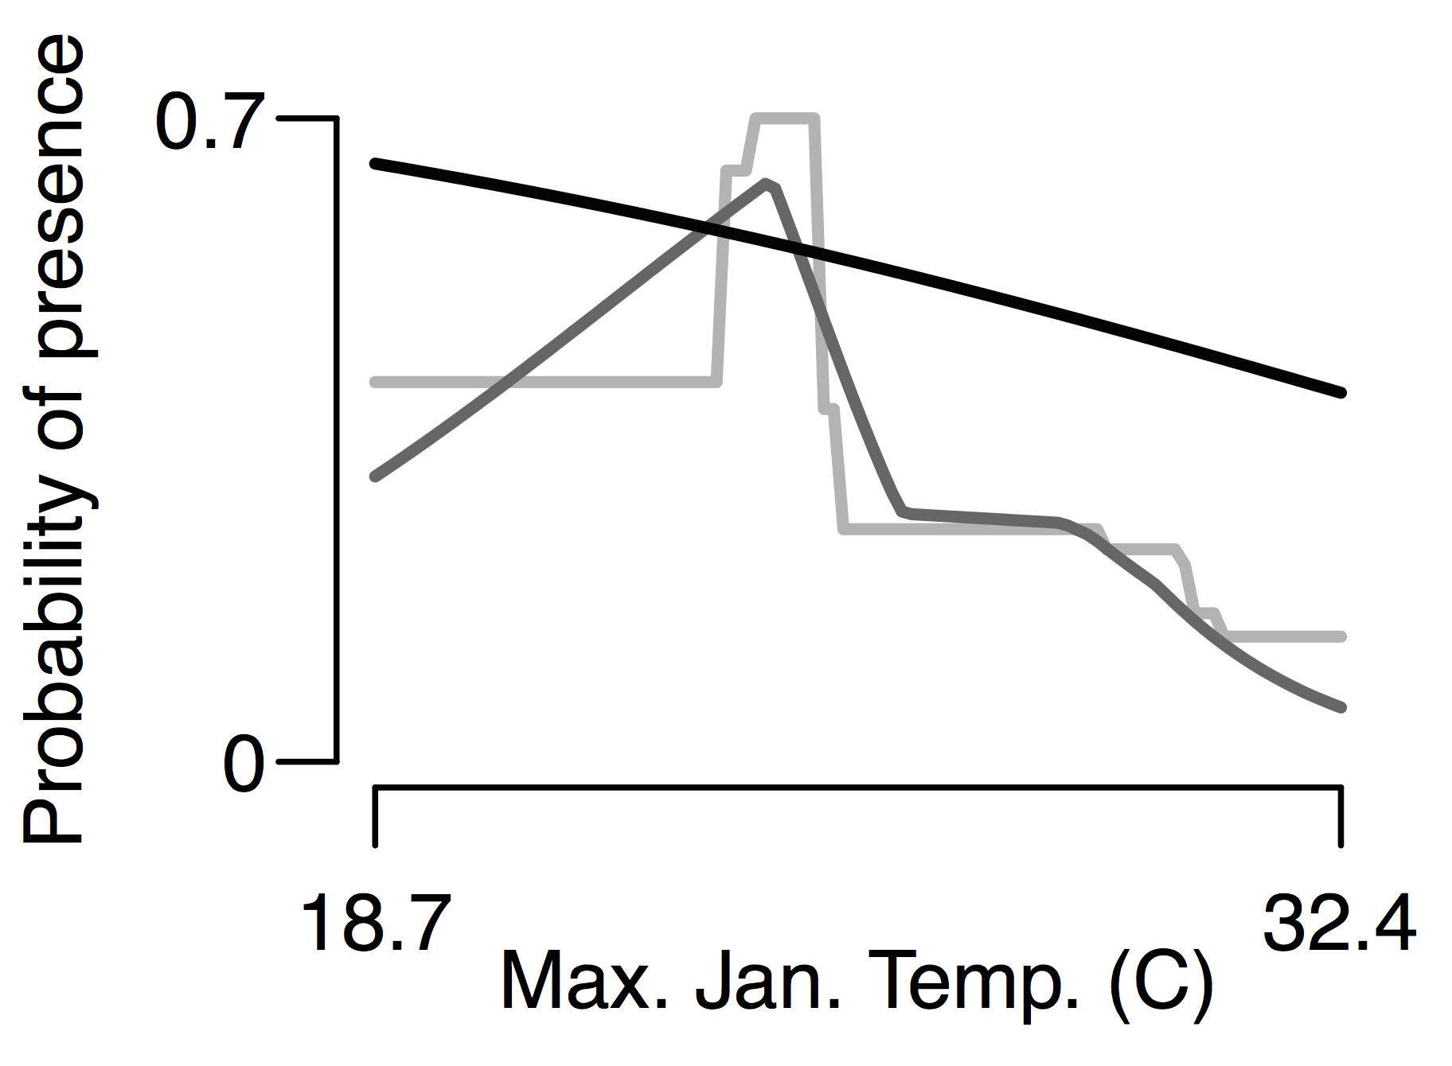
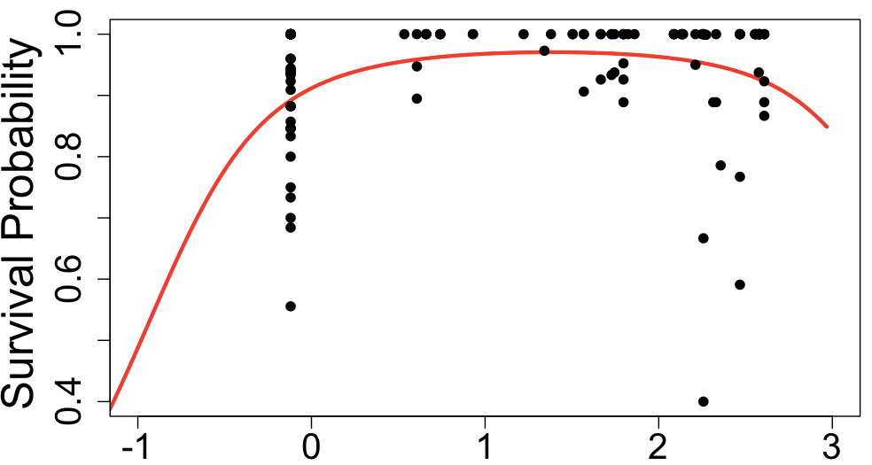
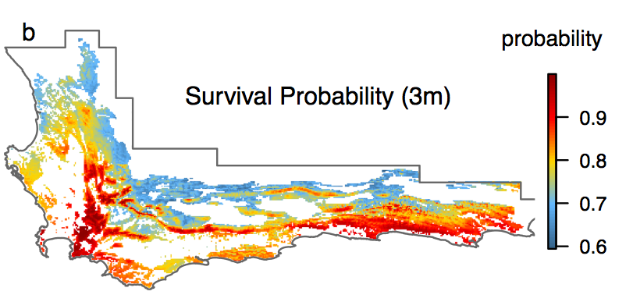

Correlative
Mechanistic
Correlative models are only useful if things don’t change too much
Need a forest
example of
something going
wrong!!
Summer rainfall
Notes:
Correlative models relate the pattern (e.g. spatial distribution) to predictors
Mechanistic models relate the process (e.g. demography, dispersal) to predictors

Slide 24
Global Change Demography Biodiversity Communities Synthesis
Mechanistic Forecasting
Demography
Notes:
fundamental units of ecological change – processes.
Like a physical theory – electrons an protons are the fundamental units interacting via the electromagnetic force, we need an analogy in ecolgoy
Units=indiv; process=demog
Species don’t respond to climate, individuals respond to weather.
They respond by surviving, growing and reproducing
Disturbance – indiv die due to a fire

Slide 25
Global Change Demography Biodiversity Communities Synthesis
Mechanistic Forecasting
climate
disturbance
Demography
biotic
interactions
survival
reproduction
growth
dispersal
land use
traits
Notes:
My researc: some primary drivers
Traits kind fo count because they’re a shortcut – honorary member
to emergent properties

Slide 26
Global Change Demography Biodiversity Communities Synthesis
Mechanistic Forecasting
climate
population
dynamics
disturbance
Demography
ranges
biotic
interactions
survival
reproduction
communities
growth
dispersal
land use
ecosystems
traits
Notes:
May not be obvious to others tthat we don’t have large scale mechanistic data or the people use correlative approaches

Slide 27
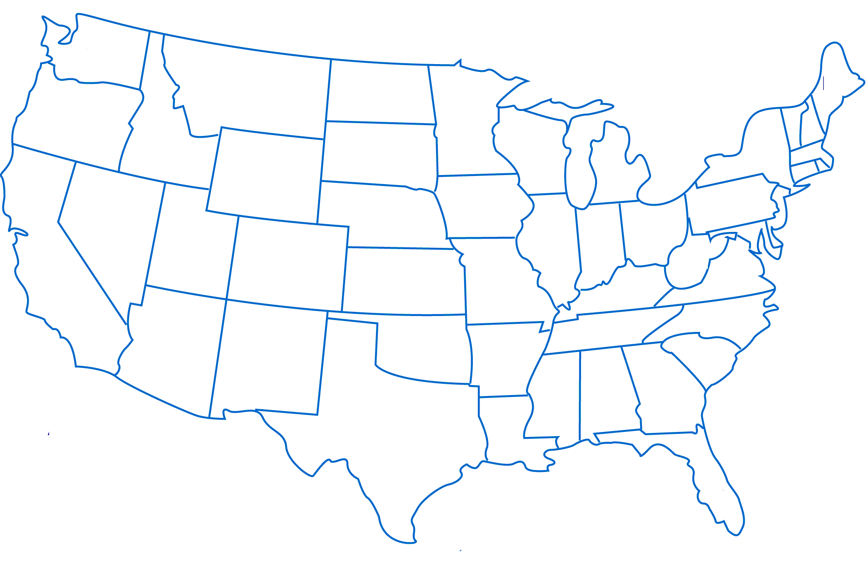
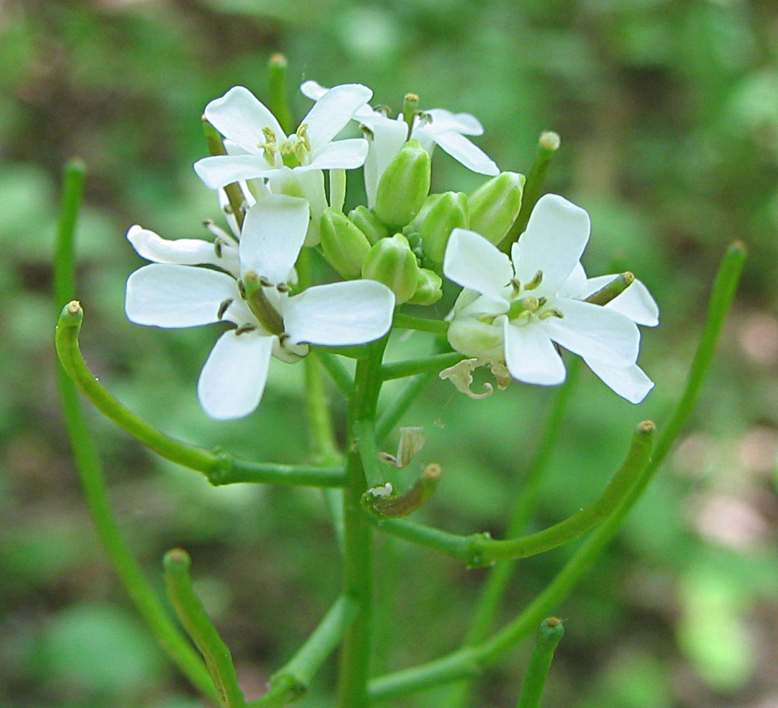
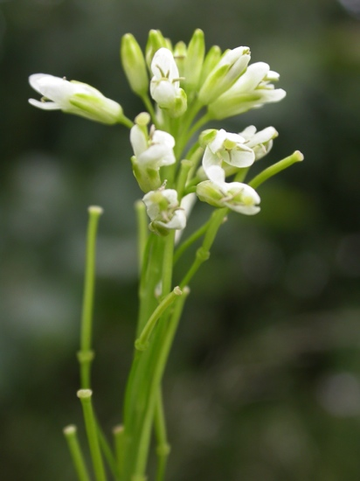
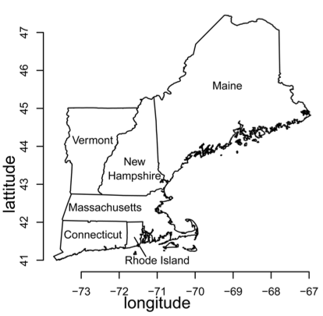
How will climate change affect invasion?
Global Change Demography Biodiversity Communities Synthesis
Invasive
Garlic Mustard
Alliaria petiolata
Native
Tower Mustard
Arabis glabra
Merow, et al. PNAS, 2017
Notes:
Two bienniels,
Garlic :widespread
edge and understory
Tower: edge
Understand demographic basis for invasion; vacant niche?

Slide 28
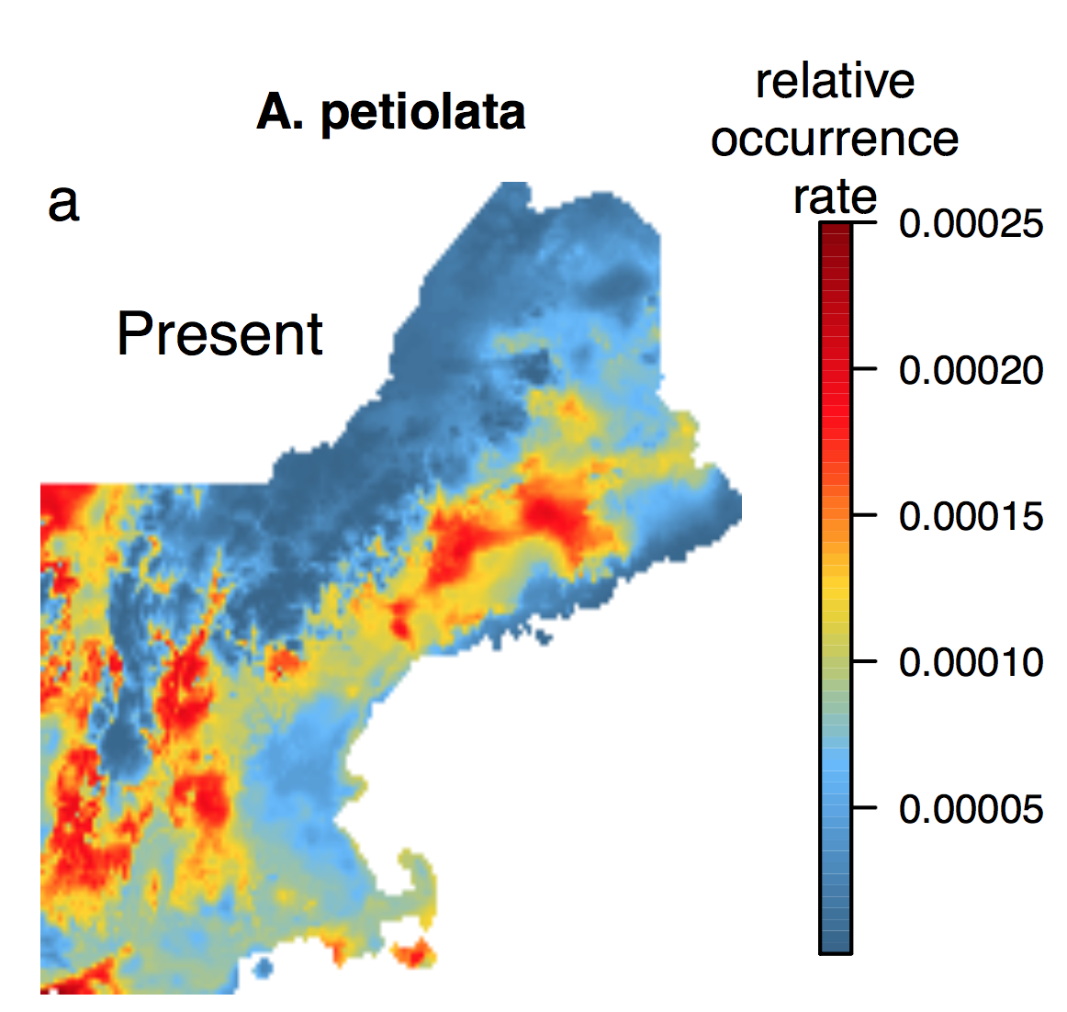
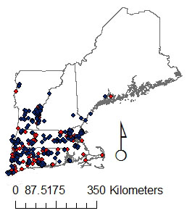
Invasions require extrapolation
Global Change Demography Biodiversity Communities Synthesis
What we ‘know’ already…
?
Occurrence
model
Merow, et al. PNAS, 2017
Notes:
Always extraplating in geographic space, often in environmetnal space too

Slide 29
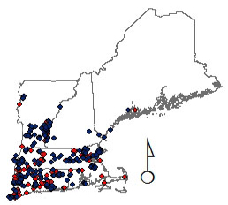
Objectives
Global Change Demography Biodiversity Communities Synthesis
Are uninvaded regions suitable?
How will climate change affect invasion?
How can demography inform management?
What is the demographic basis for invasion?
Tower Mustard
Merow, et al. PNAS, 2017

Slide 30
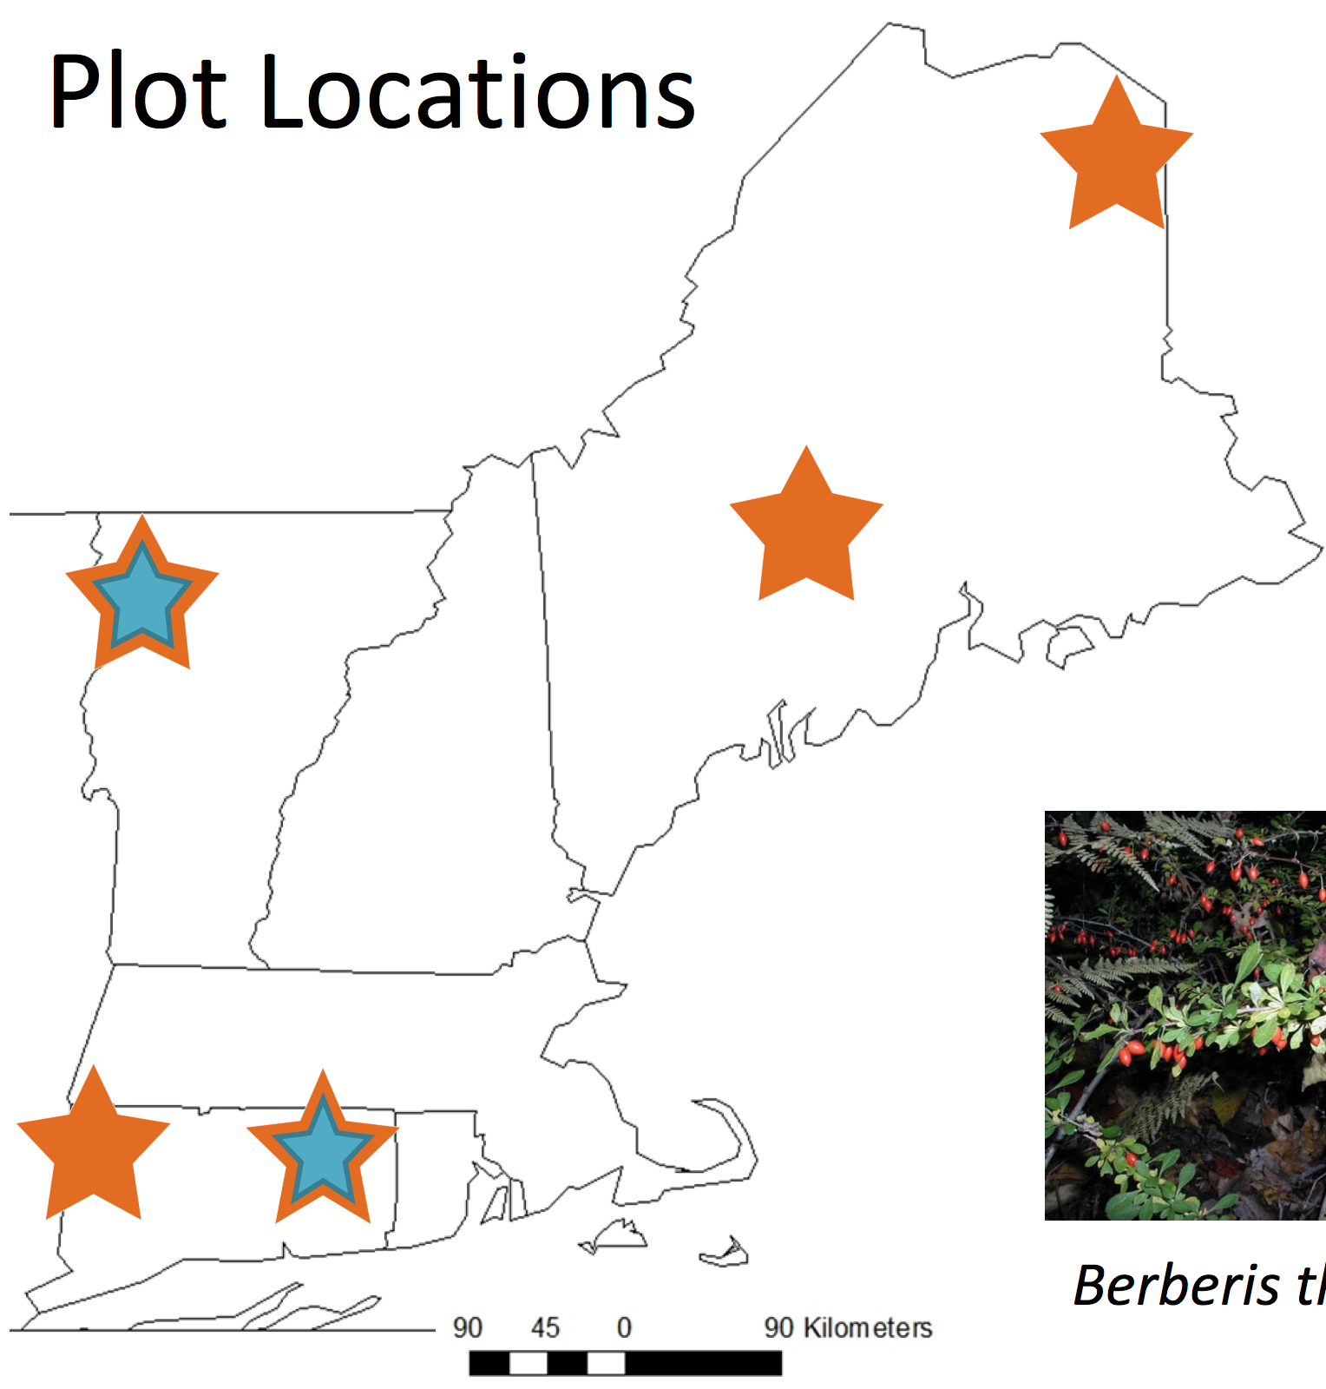
Data
Global Change Demography Biodiversity Communities Synthesis
Predictors
PAR (Light)
pH
Nitrogen
Temperature Warmest Month
May precipitation
Demography
survival
growth
21 plots
open/closed canopy
reproduction
Merow, et al. PNAS, 2017
Notes:
Common garden EXPERIMENT
21 plots, 5 years
Transplant in natural locations
ESTABLISHMENT RISK - Predicting ability to invade (5 generations)

Slide 31
Vital rate models
Growth
Average growth/year ~ Environment
Notes:
We’re not talking about these variables, just what they are
Used stepwise DIC variable selection
Avg growth after disturbance (growth increment)

Slide 32
Vital rate models
Growth
Average growth/year ~ Environment
Survival
% Survival ~ Size + Environment
Notes:
Surival – parent seedling ratios where we impute the number of germinatns and adult mortality transects where we impute size from age. I can talk more about this if anyoen is interested.

Slide 33
Vital rate models
Growth
Average growth/year ~ Environment
Survival
% Survival ~ Size + Environment
Fecundity
Flowering Probability ~ Size + Environment
# Flowers/Individual ~ Size + Environment
Seeds/Flower = 74
Germination = 1.1%
Offspring size
Size ~ Environment
Notes:
some we dont model as a function of env because we don't know about thier differences
Germination was a bit of complicatate model where we imput the number of seeds based on parent size for site 1 year after burn.
All of these measurements were made with a single visit. Plenty of problems, but helps us to ask lots of better questions and get an idea of what new data we need to collect to refine distribution and understanding

Slide 34
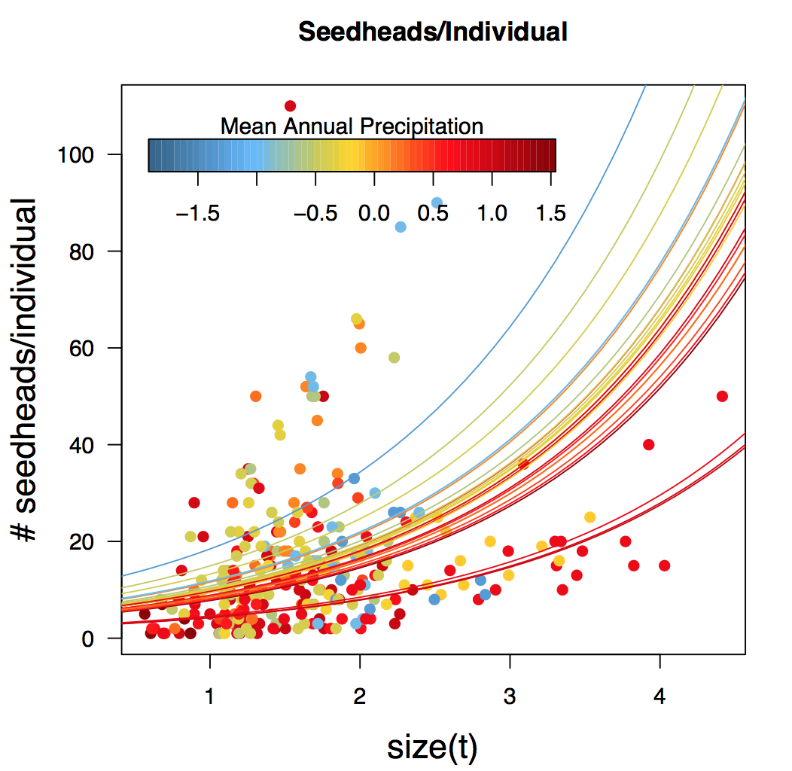
Vital Rate Models
Notes:
Maybe use survival as an example of borrowing across data sets
We can interpret these response curves just like we interpret response curves for occurrence models, but with the advatange that we’re focusing on a single demographic process. This makes extrapolation
Felxibility comes from modeling a handful of interactions between size and environment.
A size^2 term ensures that we don’t predict a ridiculous number of seedheads for the largest individuals (the largest had 110)
We don’t have to worry about what goes for individuals>size 5 because they don’t survive that long.

Slide 35
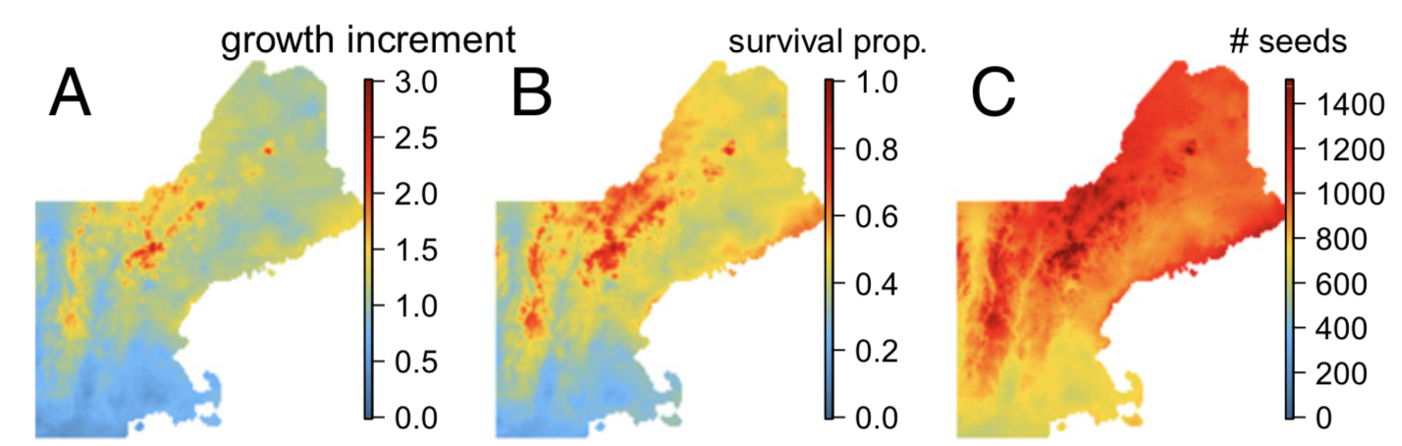
Vital Rate Models

Slide 36
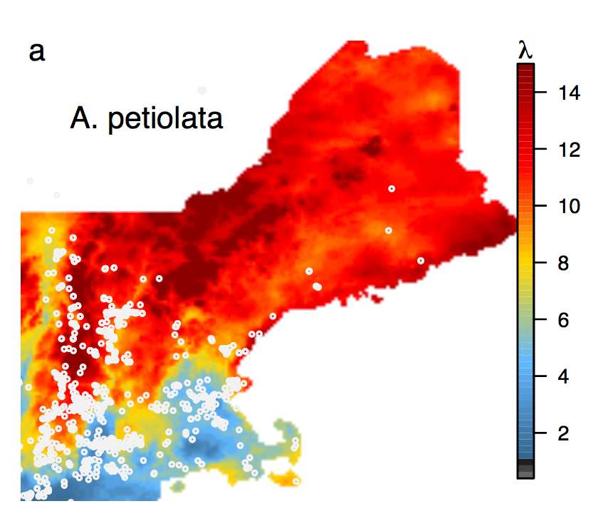
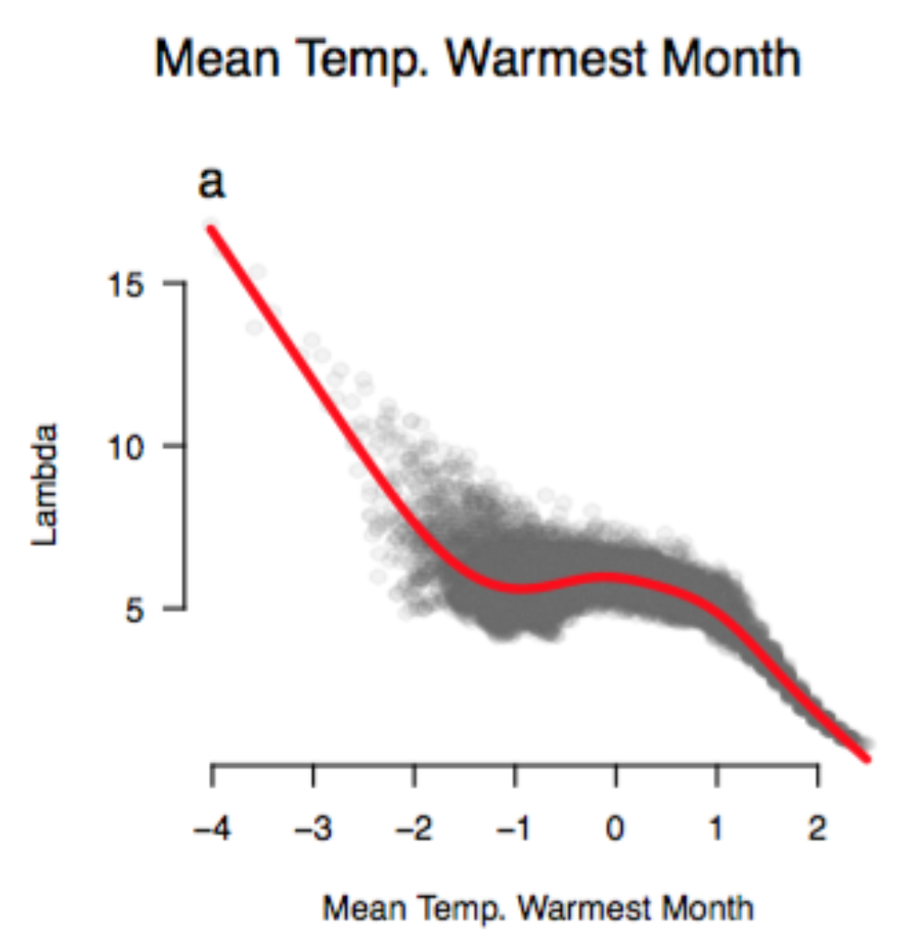
What drives the climate response?
Global Change Demography Biodiversity Communities Synthesis
Merow, et al. 2017 PNAS
Notes:
now focus on garlic mustard
So, what are the implications under future climate change

Slide 37
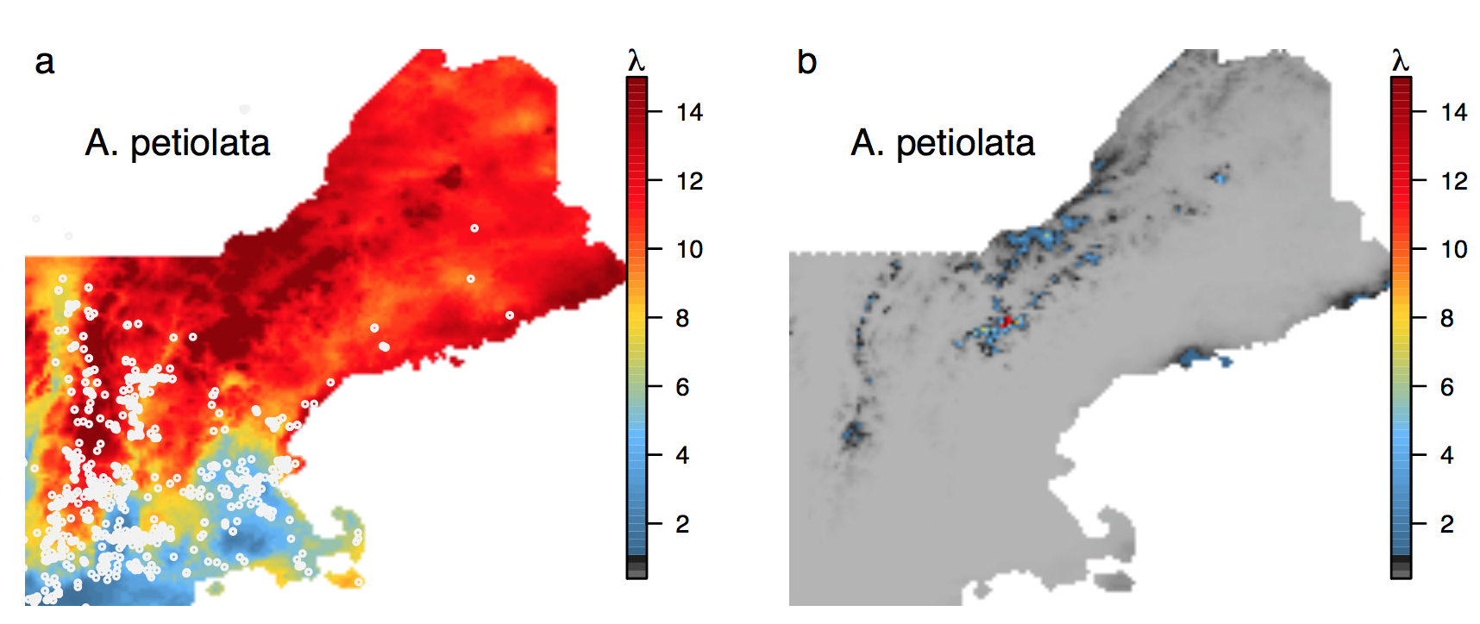
How will climate change impact invasion?
Global Change Demography Biodiversity Communities Synthesis
Present
2050 (RCP4.5)
Merow, et al. 2017, PNAS
Notes:
Rcp 4.5: mean .9-2 degree warming
Can’t establish.
There could be nice micro habitat still
Seed bank could help if there’s a nice year.

Slide 38
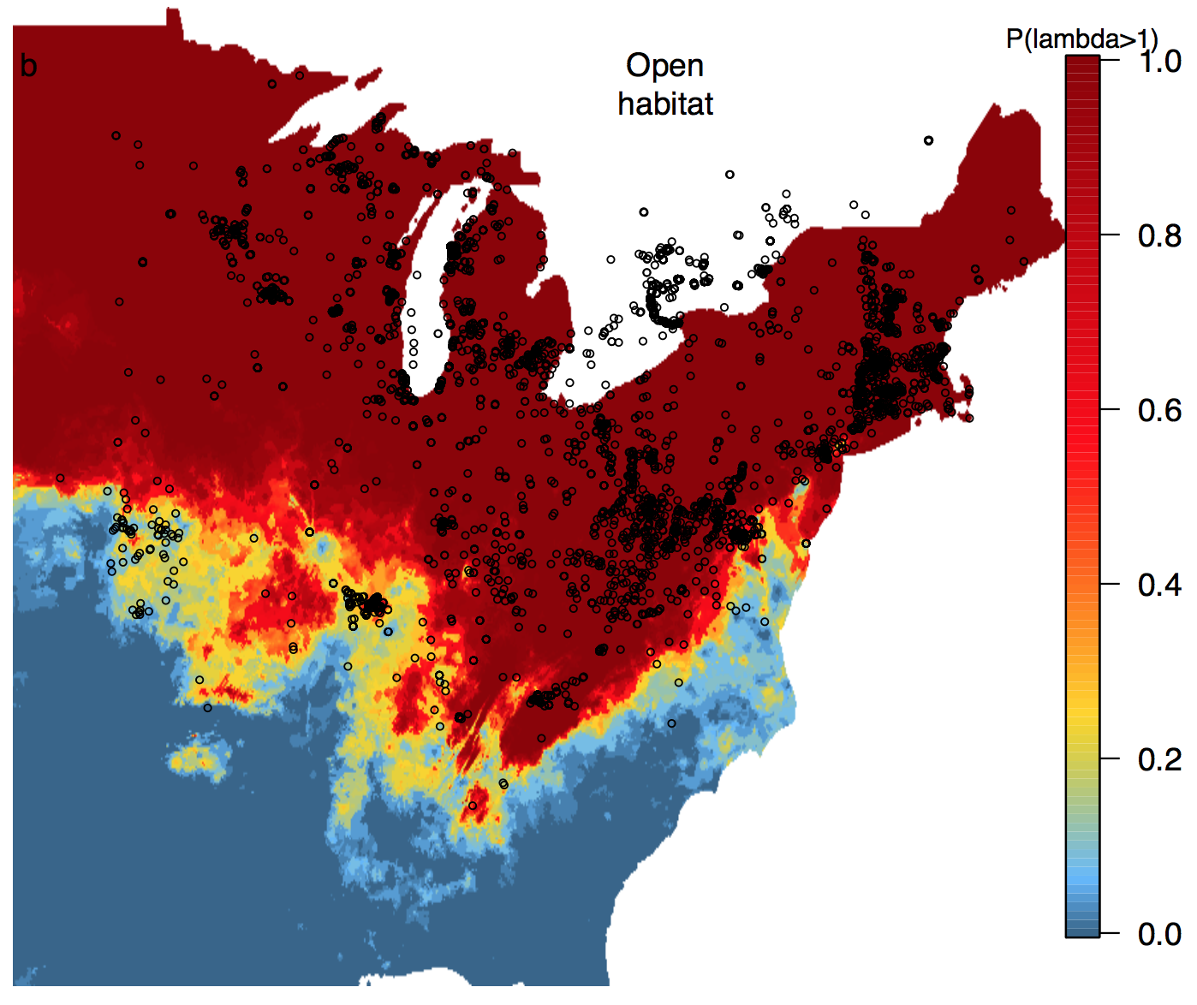
How will climate change impact invasion?
Global Change Demography Biodiversity Communities Synthesis
Merow, et al. 2017, PNAS
Notes:
Some of the highest fluctuations in temp in the country
Not accounting for any other predictors!

Slide 39
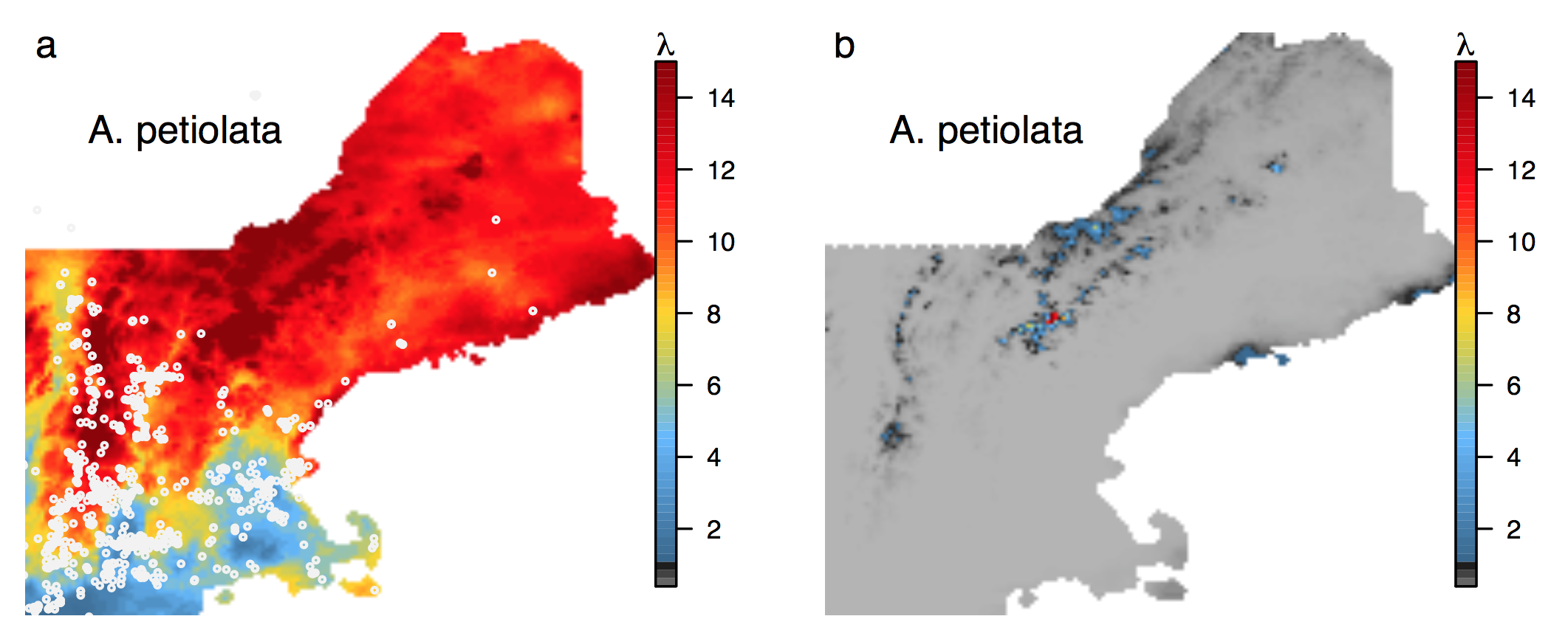
How will climate change impact invasion?
Global Change Demography Biodiversity Communities Synthesis
Present
2050
Merow, et al. 2017, PNAS
Notes:
So I’m not saying that climate change will take care of invasives for us, but that this shift the research agenda away from managing existing populations
Canada is in trouble – are there dispersal barriers?
How will less robust native species respond?
Garlic mustard modifies the soil – what will fill it’s gap? Another invasive?

Slide 40
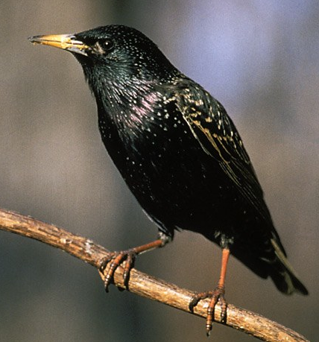
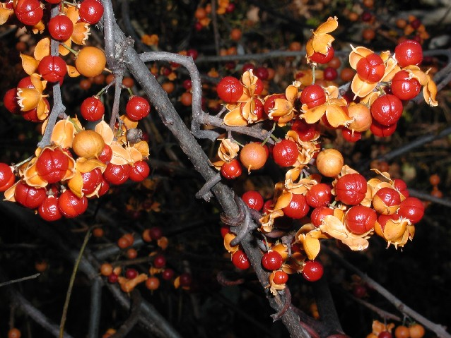
Individual based models
Predicting multiple patterns correctly provides support for the mechanisms and parameter values
Merow et al. 2011 Am Nat.

Slide 41
Uncertainty
Modeling decisions
Parameters
Future Scenarios

Slide 42
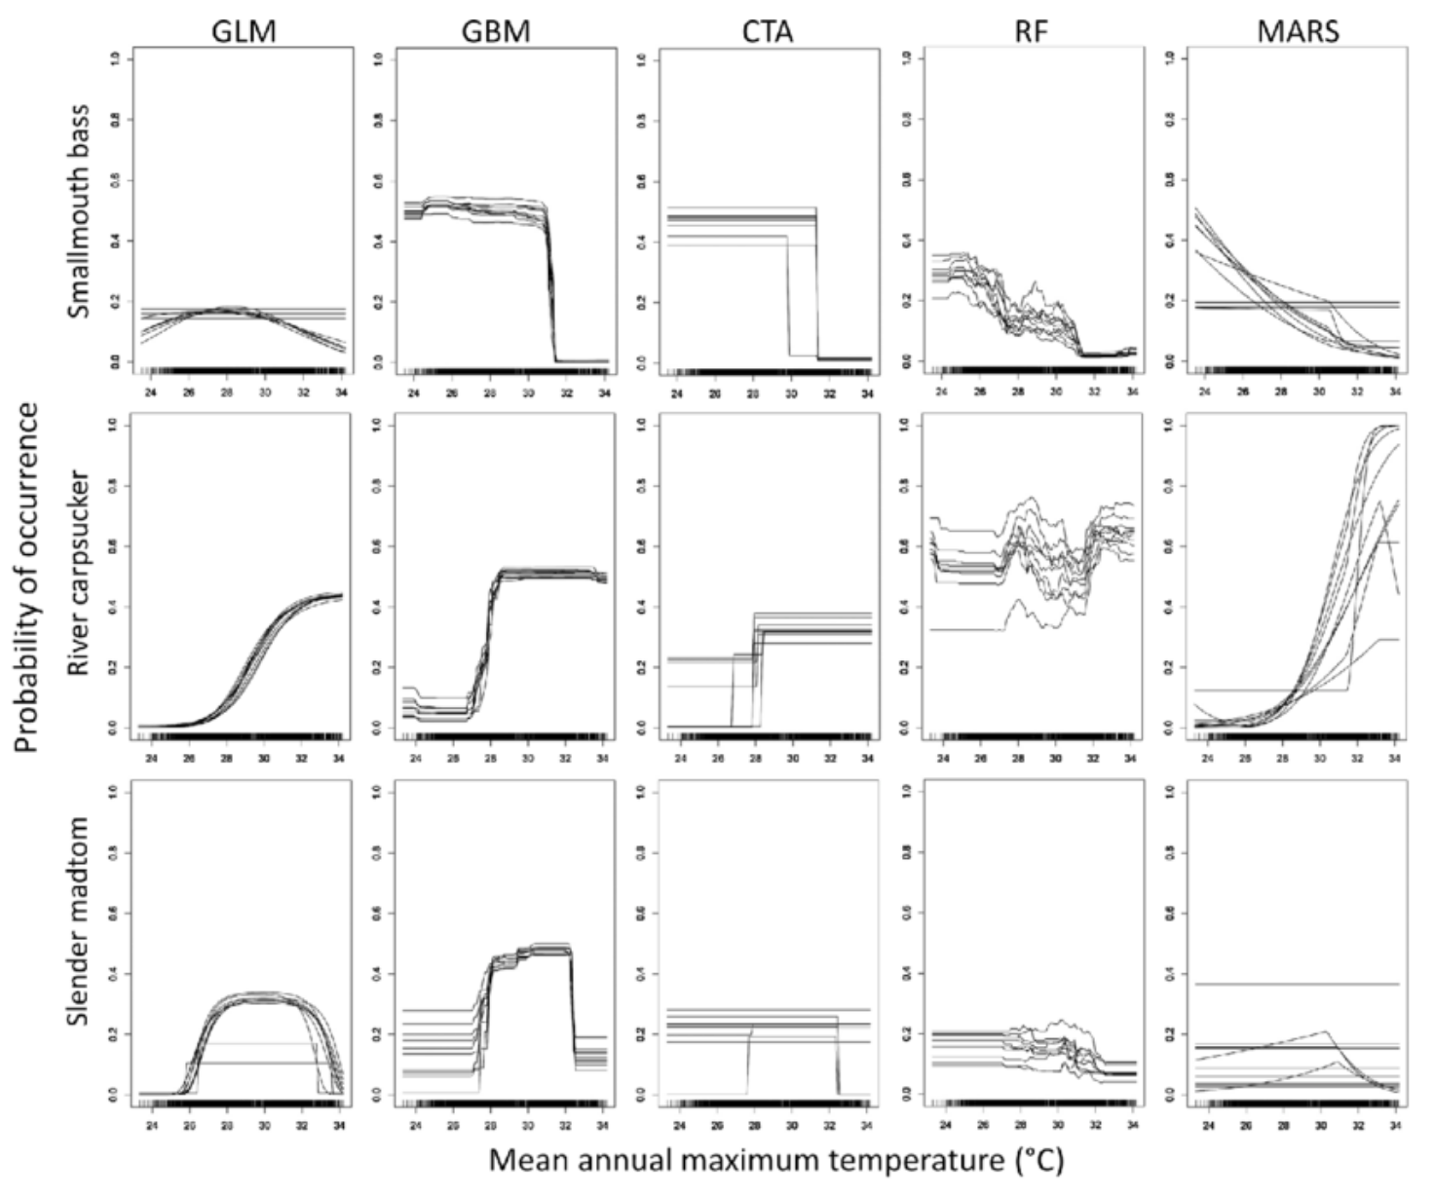
Modeling decisions: algorithms

Slide 43
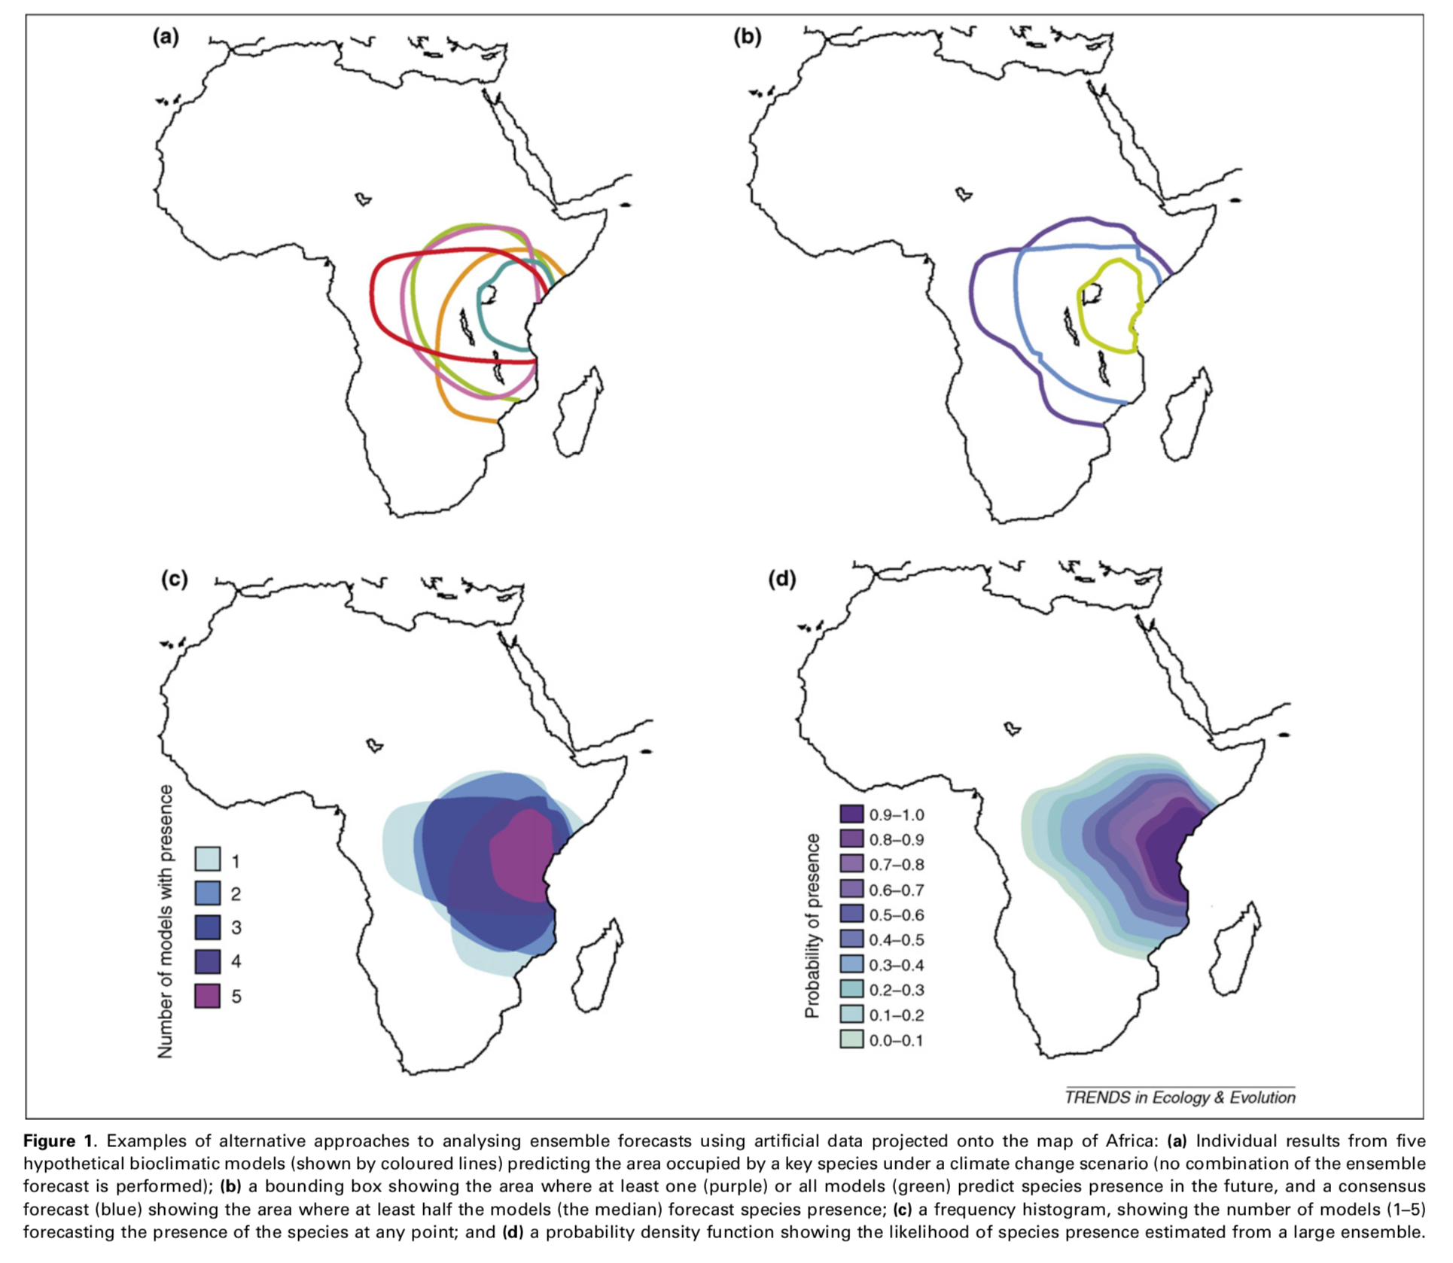
Modeling decisions: ensembles

Slide 44
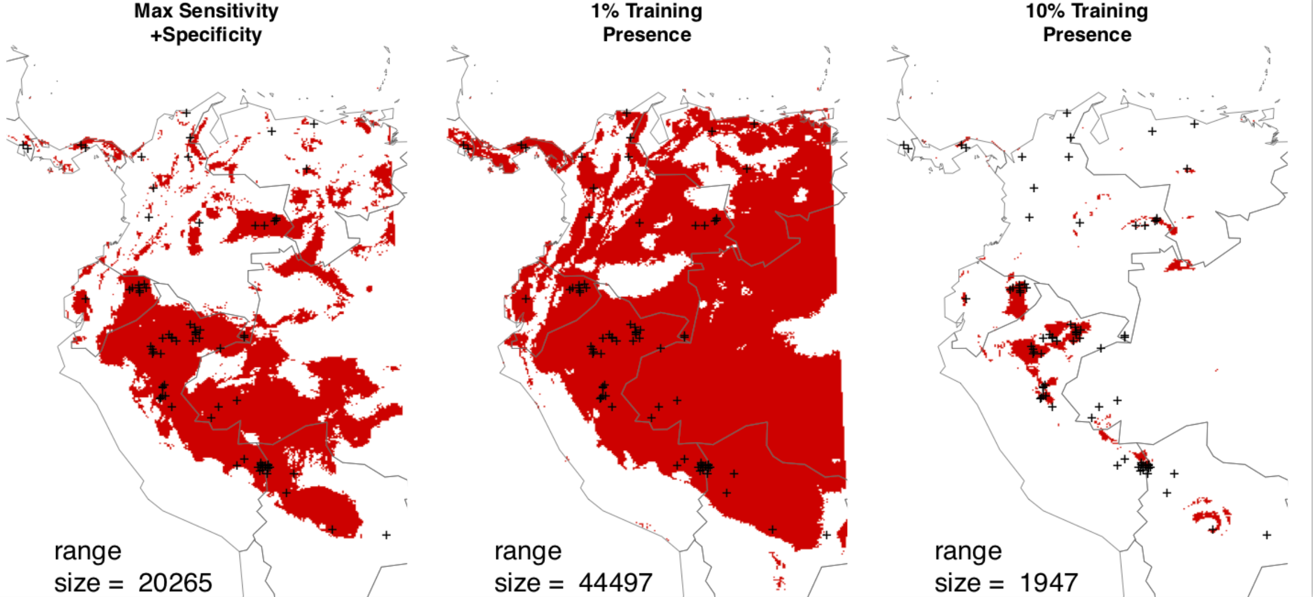
Modeling Decisions: Binary Maps
Determining the right threshold is dodgy with presence – only data
Merow et al, pretty soon
Set up the problem
Notes:
Nede binary for diversity, community, visualization, interacations.
My original solution was to complain about it when people did this as arbitrary.
it might be hard to. deterimine a single best threshold, but putting reasonable bounds is much easier. The issue is that the background points aren’t absences, so AUC isn’t ideal.
For conservation, you’re probably worried about the best habitat, not shitty places, so a higher threshold is more useful
Can be combined with other sources of uncertainty/variability, e.g. statistical, algorithm, predictors, etc.
Also just good for visualization for nonspecialists.
get distribution of range size estimated\\

Slide 45

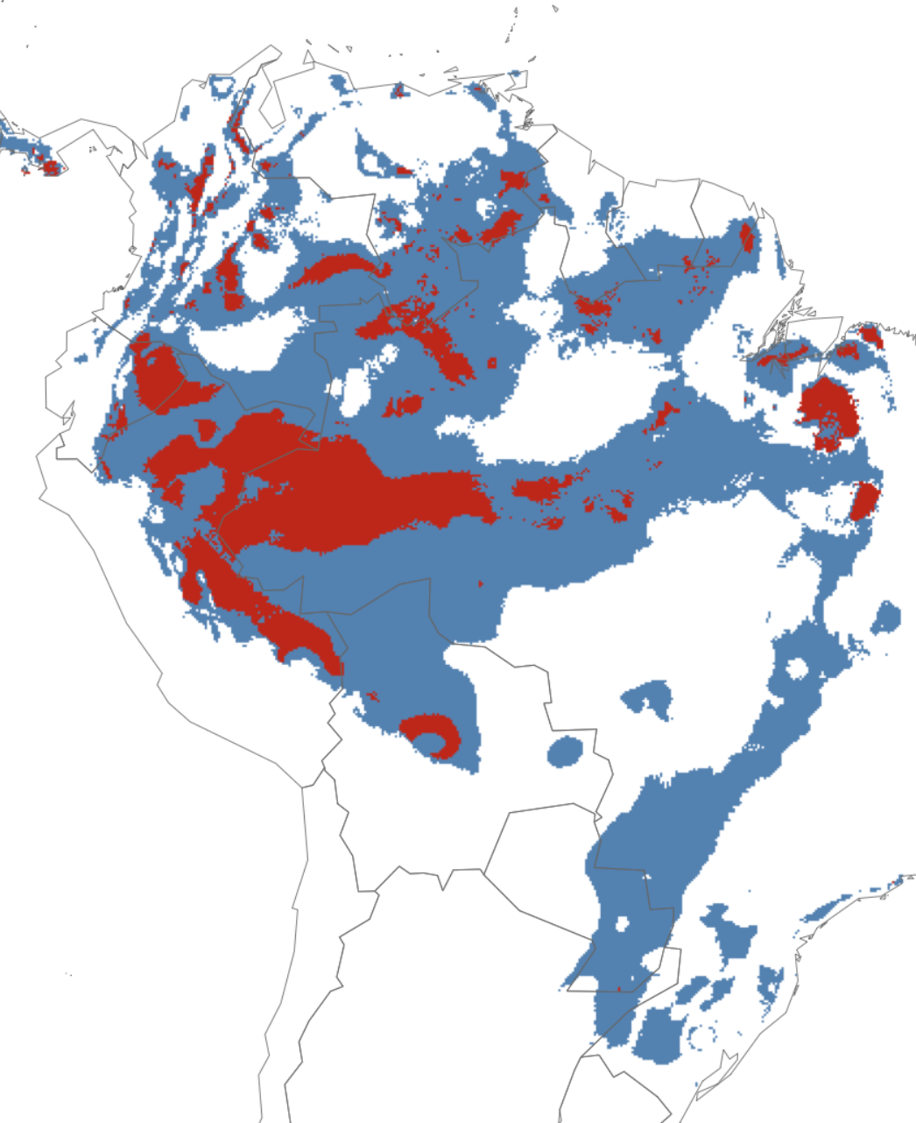
Modeling Decisions: Binary vs. Trinary Maps
Merow et al, pretty soon
Set up the problem
Notes:
Nede binary for diversity, community, visualization, interacations.
it might be hard to. deterimine a single best threshold, but putting reasonable bounds is much easier. The issue is that the background points aren’t absences, so AUC isn’t ideal.
For conservation, you’re probably worried about the best habitat, not shitty places, so a higher threshold is more useful
Can be combined with other sources of uncertainty/variability, e.g. statistical, algorithm, predictors, etc.
Also just good for visualization for nonspecialists.
get distribution of range size estimated\\

Slide 46
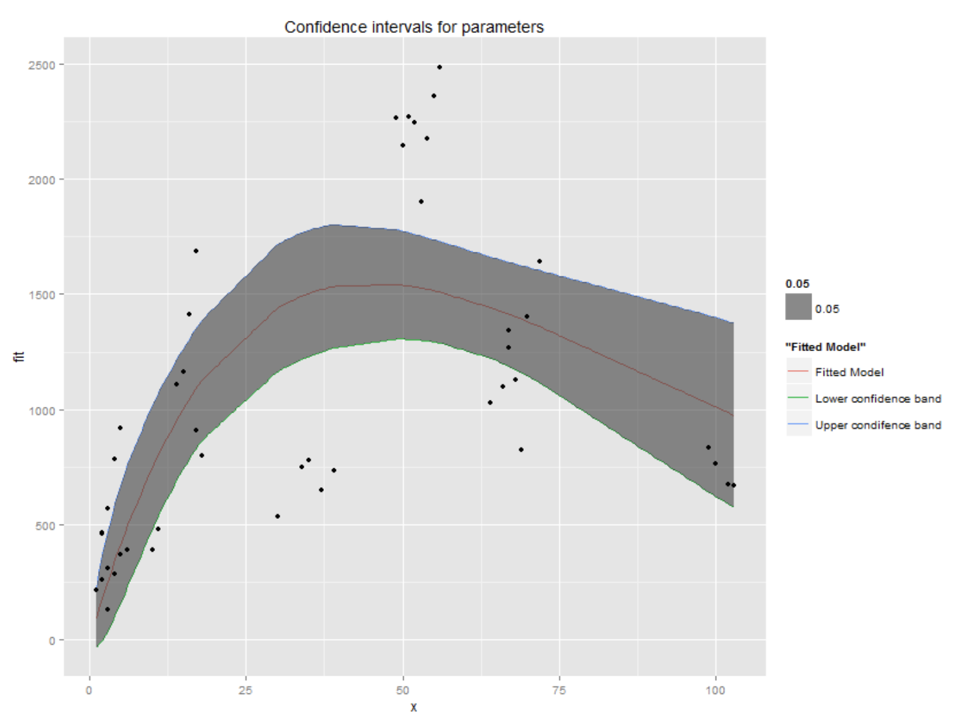
Parameter Uncertainty
Notes:
Model uncertainty correctly + Report interval estimates -> flexibility in piecing together data sets -> criticial if we’re going to use existing data to build mechanistic forecasts
-formulate hypotheses for missing data in terms of priors
-these are not huge, crazy Bayesian models, just easy little ones
-Gibbs sampling allows us to track covariance among parameters in complex models
-Choose realistic combinations of parameters for simulations
-Can also partition variation in lambda into the proportion due to variability and uncertainty like margaret has done wish Bayesian matrix models

Slide 47
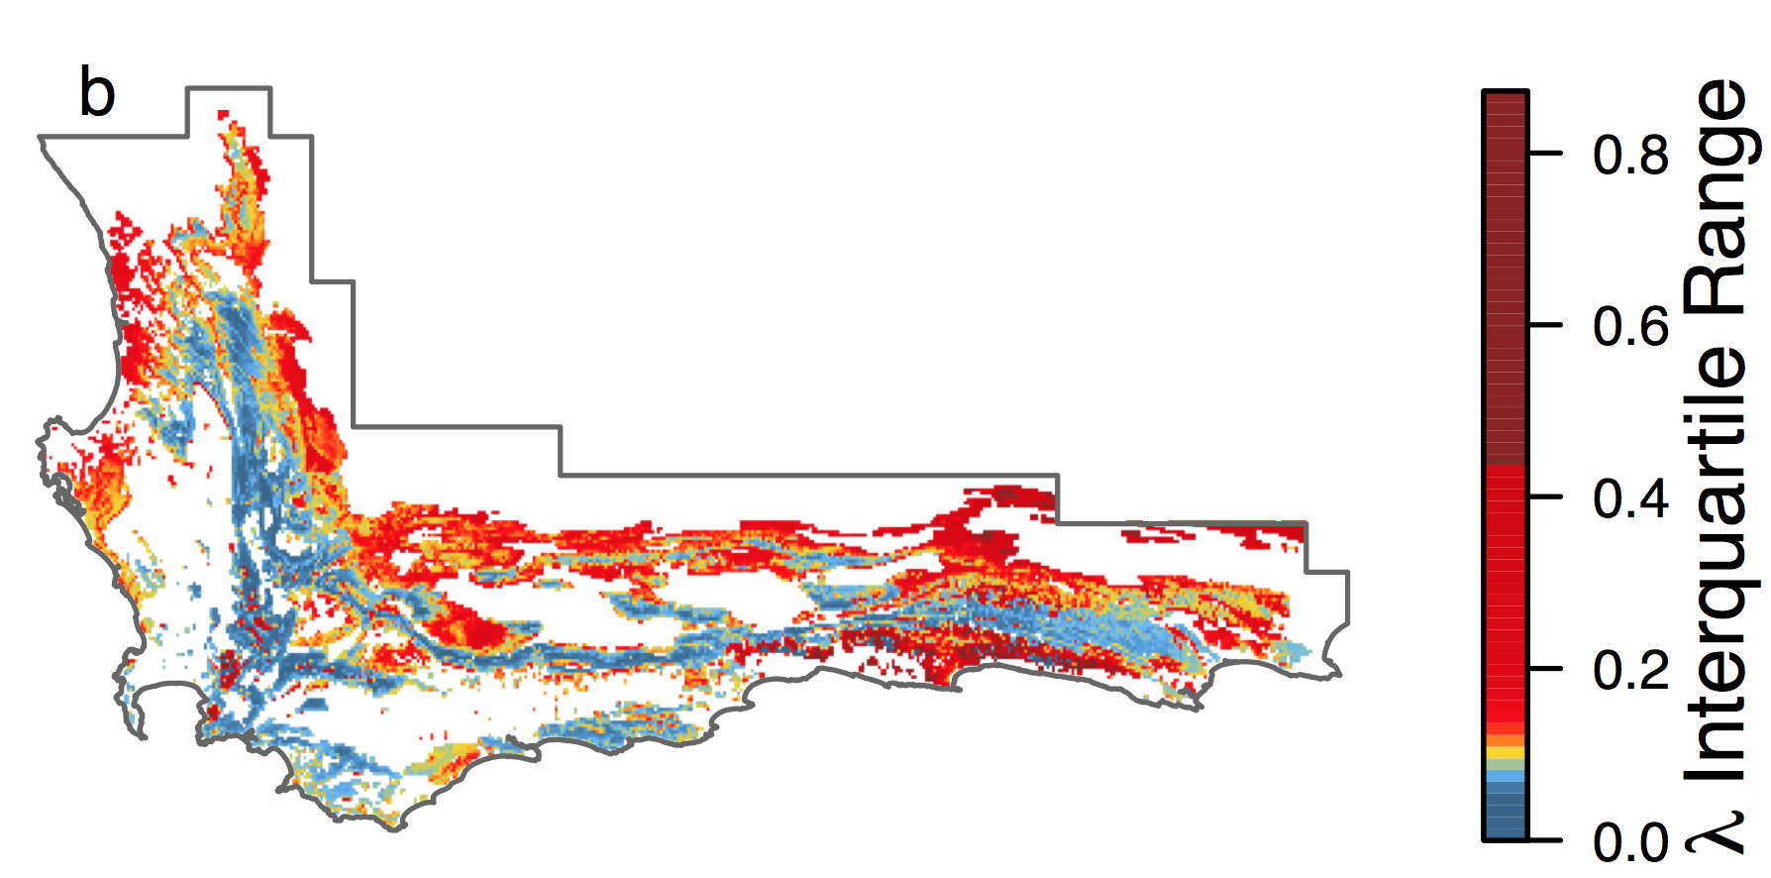
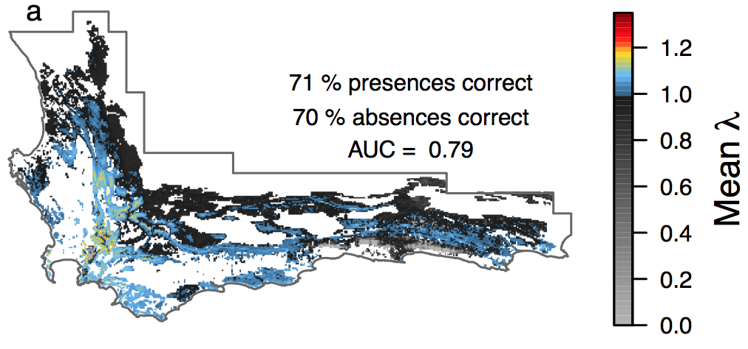
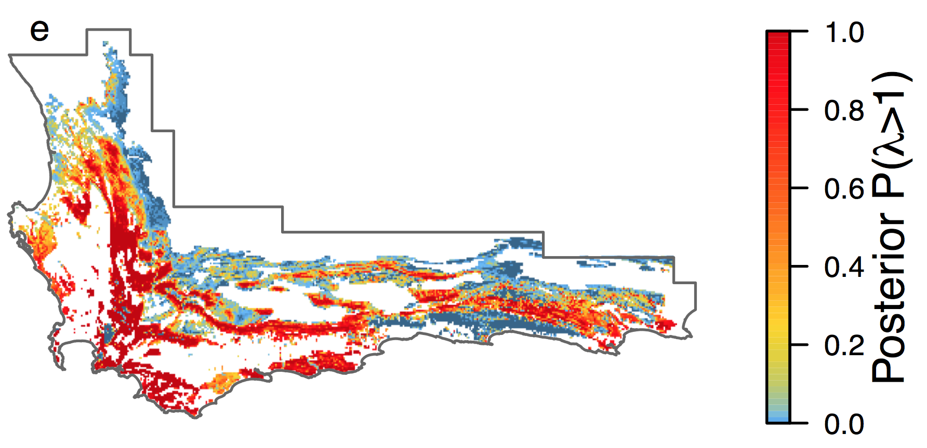
Parameter Uncertainty

Slide 48
Parameter Uncertainty
Merow, et al. 2017, PNAS
Notes:
Some of the highest fluctuations in temp in the country
Not accounting for any other predictors!

Slide 49
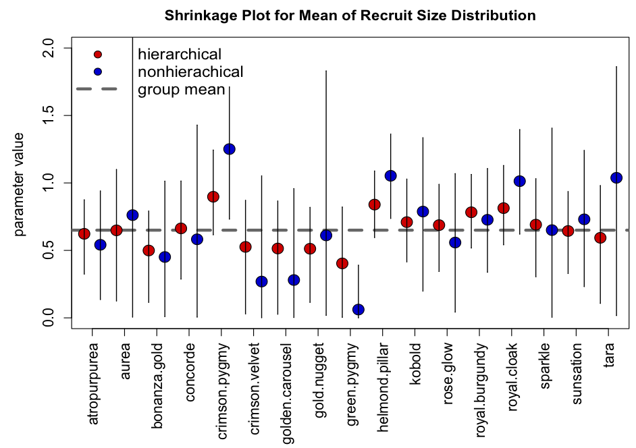
Paramater uncertainty: reduction
Trade variance for bias with random effects

Slide 50
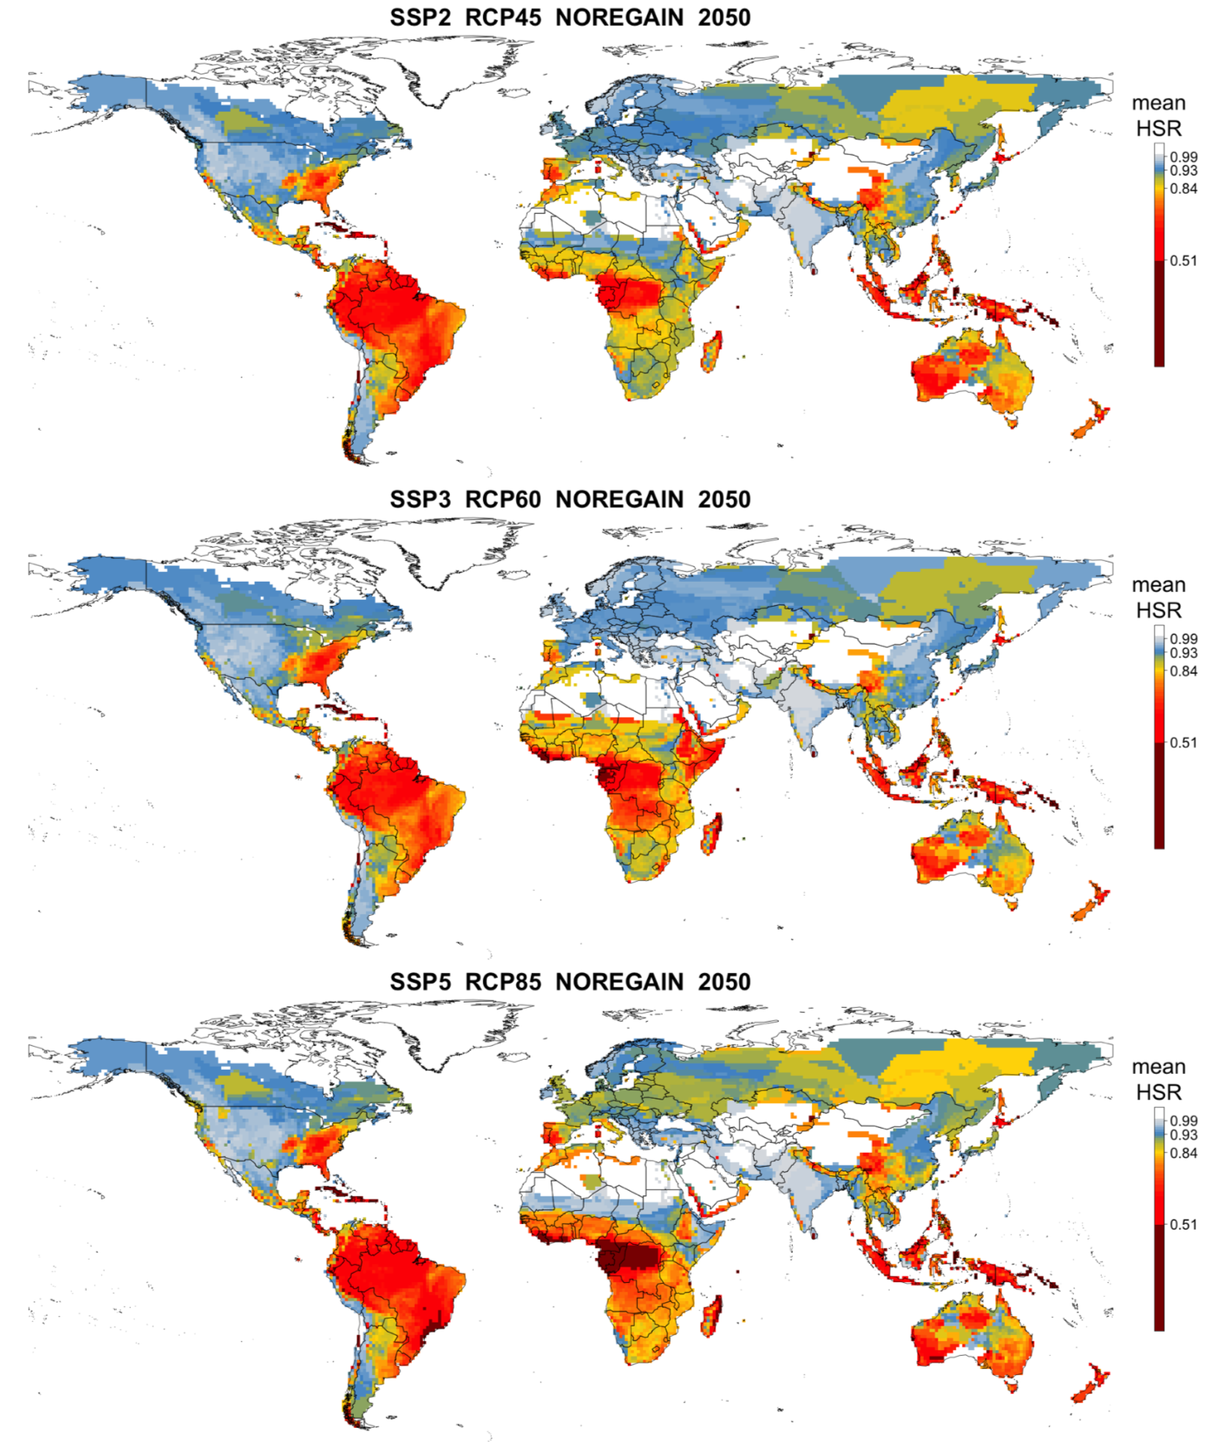
Future scenarios
Weather
Climate
Land Use
Disperal

Slide 51
Concluding thoughts
Types of extrapolation
Environment*
Space
Time
Uncertainty
Modeling decisions
Parameters
Future Scenarios
Identify the type
Reduce, report

